Slide 1
Broadband after BEAD: Planning for a digitally inclusive future
Dr. Christopher Ali
Pioneers Chair in Telecommunications
Penn State University
cali@psu.edu
@ali_christopher

Slide 2
Who am I?
Pioneers Chair in Telecommunications & Professor @ Penn State University
Phd in Communication Studies – University of Pennsylvania
Author of Farm Fresh Broadband
Senate testimony on federal funding programs for broadband
New Research: The Broadband Stories Project

Slide 3
Three claims
BEAD and DEA are the beginning, not the end of achieving digital equity
Digital exclusion will persist after BEAD & DEA because it is tied directly to structural inequality
We need to be thinking long term about digital equity & inclusion

Slide 4
Why?
Digital technologies will always arrive at urban and wealthy areas first
Digital education evolves
What matters at 15 is different from what matters at 65
Technological development doesn’t stop with IIJA
Affordability will always be a challenge
Digital exclusion maps on to other socio-economic exclusions
Think: who is most likely not to be connected?

Slide 5
Three themes
Sustainability
Economic
Resilient networks
Digital Inclusion
Redundancy
In funding programs
In network construction
Experimentation
In broadband technologies

Slide 6
Sustainability
Economics, Networks, Programs

Slide 7
Economics
BEAD represents the largest public investment in broadband in terms of capital expenditures
What about operational expenditures?
What happens when the wires are in the ground?

Slide 8
Lots of questions, few answers
Questions about future op-ex costs
Damage to fiber networks (squirrels, winters, cars)
Technical and customer service (outsource or in house?)
Inflation
Poles
Image credit: https://www.theatlantic.com/technology/archive/2011/08/squirrels-do-17-of-the-damage-to-fiber-optic-network/243319/

Slide 9
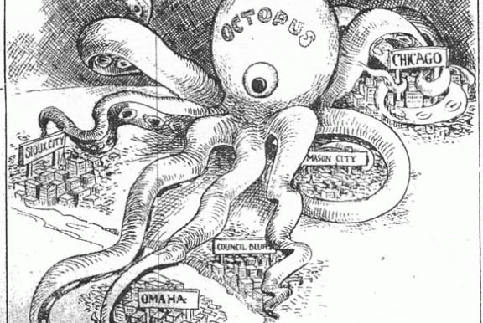
The Octopus: History Repeating? Will we see mass amounts of industry consolidation following BEAD and VC expenditures?
Image credit: http://coolinfographics.squarespace.com/blog/2007/9/21/att-a-history.html

Slide 10
Network Sustainability
Climate change requires greater investment in resilient networks
How can ISPs protect their workforce?
Sending crews home during extreme heat
How can ISPs protect their assets?
Need for electrification of fleet vehicles
How can ISPs “future proof” their networks?
Burying
Microtrenching
Dig Once

Slide 11
Electric Vehicles
New York State (2017): $3 million for municipalities and electric cooperatives to purchase electric vehicles
North Dakota Co-Op purchasing Evs
NRECA: Electric Vehicle Consortium: 85 coops in 38 states
EV charging infrastructure in rural & low-income communities
Create education-based programs to inform consumers
Explore fleet options
Demonstrate unique programs that utilize technologies to improve grid reliability
https://www.kfyrtv.com/2023/06/03/verendrye-electric-cooperative-adds-second-ev/

Slide 12
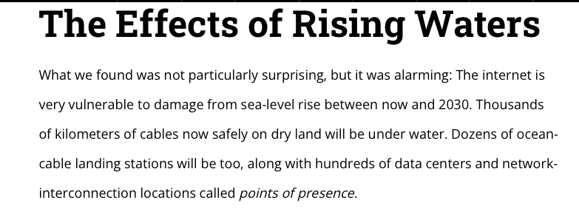
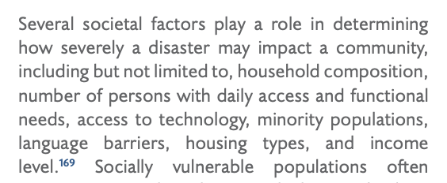
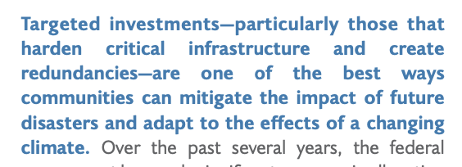
Future Proof Networks
https://www.fema.gov/sites/default/files/documents/fema_2022-npr.pdf

Slide 13
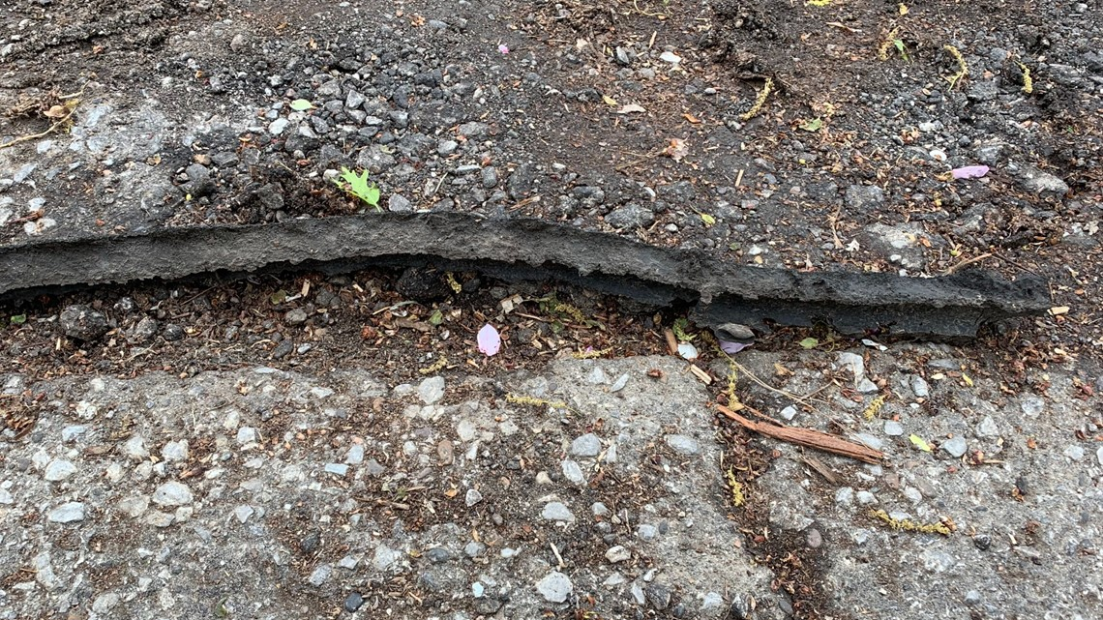
Microtrenching and Buried Cable
Broadband is more important than electricity (Focus group respondent)
Florida has a mandatory bury policy for power lines (2019)
Buried cables are not immune to flooding and water damage but do protect against cold and heat
Microtrenching
Cost efficient
GoogleFiber failure in Lousivlle, in 2019
Only 2 inches down (standard is 5-12)
Image credit: https://www.whas11.com/article/news/google-fiber-to-pay-louisville-over-38-million-to-fix-roads/417-8ea31bdc-ea43-4ea3-9054-a46c44f29ac0

Slide 14
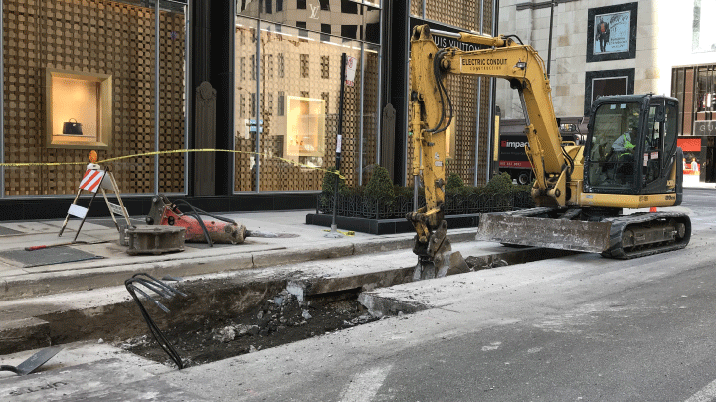
Dig Once
16 states have dig once policies (according to FOA, 2020)
Arizona, California, Colorado, Georgia, Illinois, Iowa, Maine, Maryland, Massachusetts, Minnesota, Nevada, New Mexico, North Carolina, Texas, Utah, West Virginia
FHWA 2013: 90% “of the cost of deploying broadband is when the work requires significant excavation of the roadway”
2012 GAO: Dig once policies lower the cost of road and utility projects up to 33% in urban areas and 15.5% in rural areas
Image credit: https://www.duraline-europe.com/en/about-us/news/dig-once-best-practices/

Slide 15
California Assembly Bill No. 41 2021
(1) Existing law vests the Department of Transportation with full possession and control of state highways and associated property. Existing law requires the department to notify companies and organizations working on broadband deployment on its internet website of specified department-led highway construction projects and authorizes those companies and organizations to collaborate with the department to install broadband conduits as part of those projects.
This bill would require the department, as part of those projects that are funded by a specified item of the Budget Act of 2021 and that are located in priority areas, to ensure that construction includes the installation of conduits capable of supporting fiber optic communication cables.
(2) Under existing law, the Public Utilities Commission has regulatory authority over public utilities, including telephone corporations. Existing law requires the commission to develop, implement, and administer the California Advanced Services Fund program to encourage deployment of high-quality advanced communications services to all Californians that will promote economic growth, job creation, and the substantial social benefits of advanced information and communications technologies.
This bill would require the commission, in collaboration with other relevant state agencies and stakeholders, to maintain and update a statewide, publicly accessible, and interactive map showing the accessibility of broadband service in the state, as provided.

Slide 16
Sustainability in digital inclusion
Ongoing programs
Long term planning not just one-off classes or programs
Learning is a cradle to grave issue
Libraries and…
Need committed organizations to step up to the sustainable plate
Thinking beyond DEA funding

Slide 17
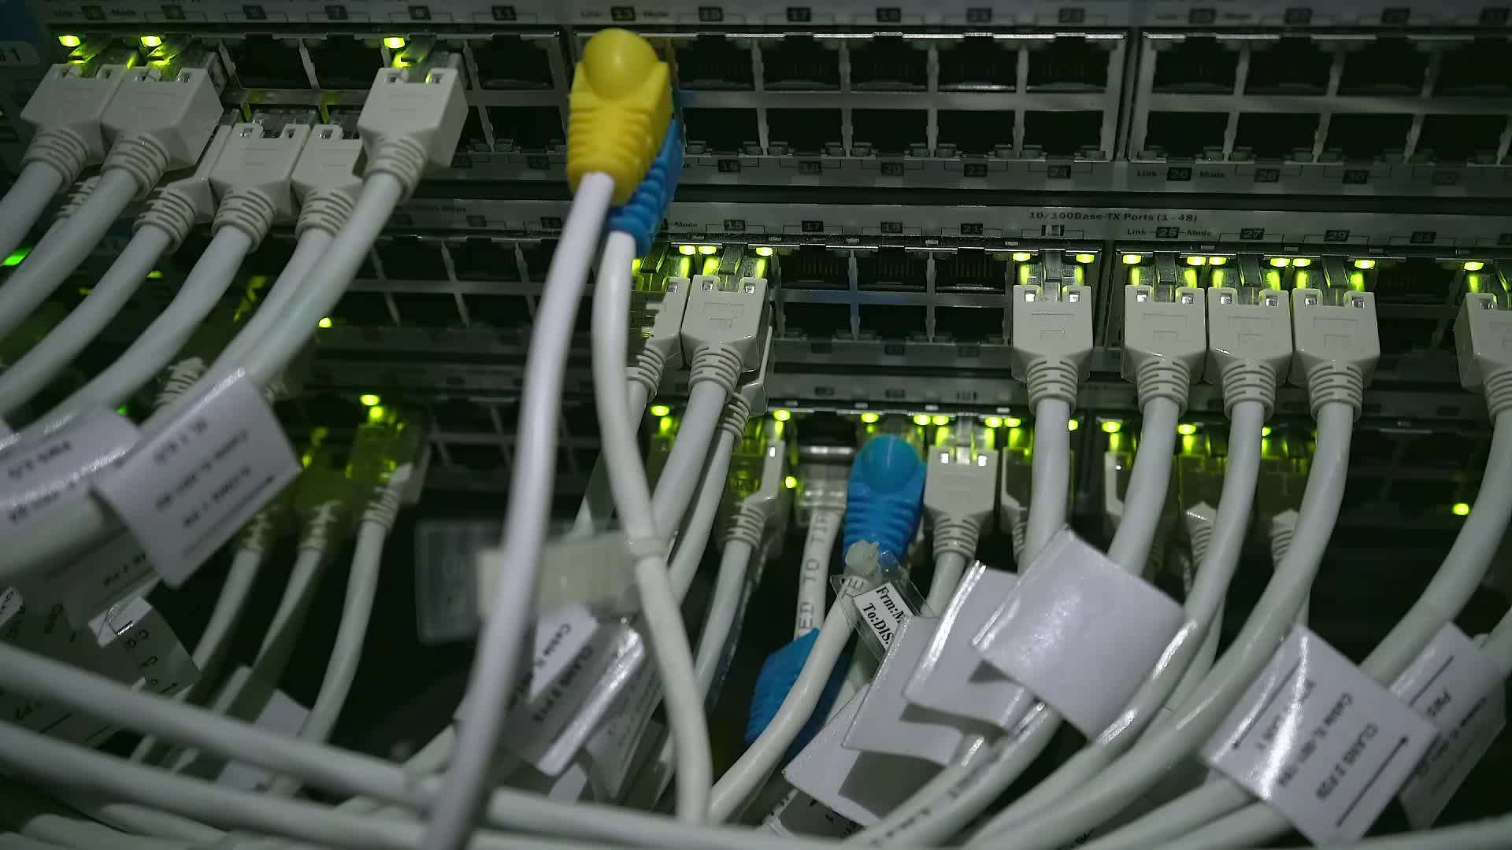
Redundancy
Networks & Programs

Slide 18
“Overbuilding”
Is the priority to ensure affordable, high-speed broadband through local monopolies or through competition?
1996 Telecom Act encourages competition across sectors
Is it overbuilding to fund a competitor when residents are dissatisfied with the incumbent?
Image credit: https://info.aldensys.com/joint-use/3-ways-to-avoid-joint-use-utility-pole-overloading

Slide 19
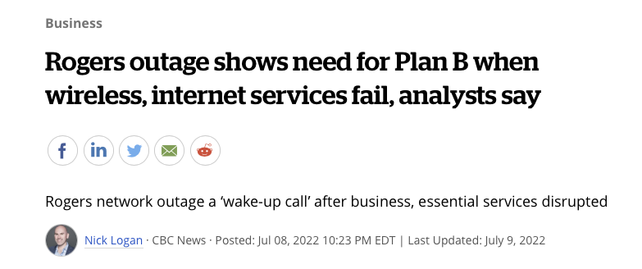
Lessons from the Great White North

Slide 20
Sallet (2019)

Slide 21
Program inoperability
99% of RUS telecommunication loan awardees depend on USF support (476/480)
Citation: https://www.everycrsreport.com/files/20130625_R42524_2ad8e00bdf3fd9d48f73543543574c5ac7290a78.pdf
FCC high cost support used for op-ex, BEAD used for cap-ex: Why not make them compatible?
Needed changes to USF

Slide 22
By the numbers
RDOF:
Reconnect:
BEAD:
NO RDOF; NO RE-CONNECT
Can’t use state or USDA support
“Applicants receiving other federal funding to deploy broadband in all or part of the PFSA are eligible”
”subject to enforceable federal, state or local commitment to deploy qualifying broadband”

Slide 23
ACP
Need for congressional intervention
A heartbreak
People still need convincing
“Handouts”
Community partners!
Revise USF
ACP as op-ex for small ISPs?
State/County Augmentation
California Lifeline adds $19
Albemarle County, VA adds $20 to ACP

Slide 24
Experimentation
The future of wireless

Slide 25
Lots of debate as to the future of wireless
Starlink
Mobile provided FWA
A fiber first national strategy
An immediate need vs. a long term strategy
Image Credit: https://www.counterpointresearch.com/fwa-subscribers/

Slide 26
Fiber first does not mean fiber only! BUT “Wireless means just one wire, less”

Slide 27
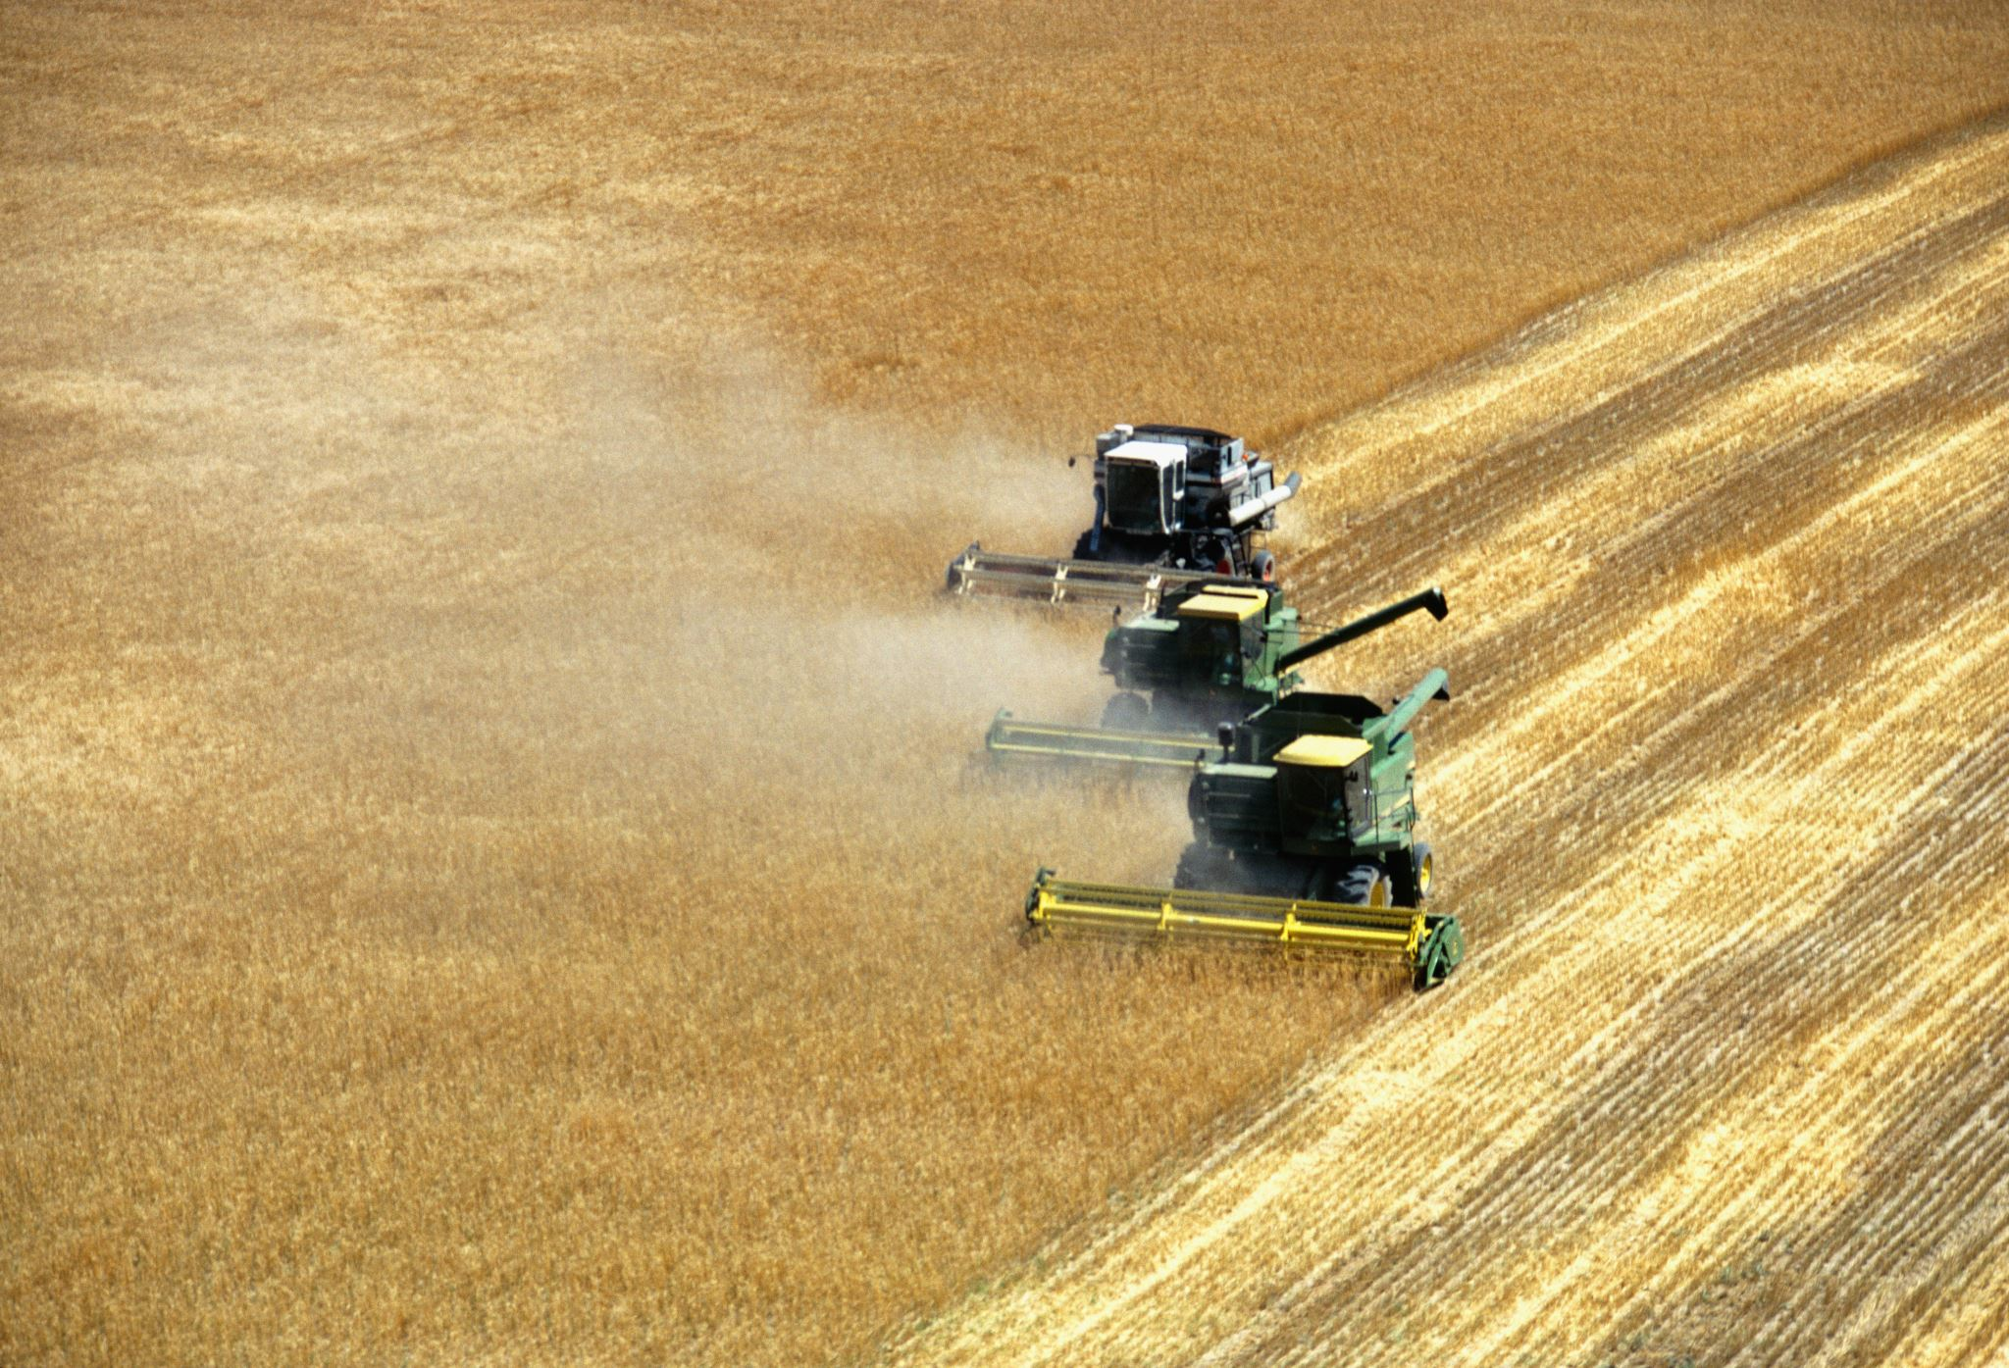
The need for wireless solutions
Globally, more people access the internet wirelessly
Wireless is particularly important for (precision) agriculture
BUT mmWave will not work for ag!
Wireless for automated vehicles
Wireless in times of crisis
Wireless for first responders
Wireless to bridge the gaps in rural and remote coverage in the US/Canada

Slide 28
The pressing need to continue developing wireless technology

Slide 29
Where else can we experiment?
Where does digital learning take place?
Grocery stores
Take out pizza
Churches
Parks and outdoor spaces
On the bus

Slide 30
Concluding Questions

Slide 31
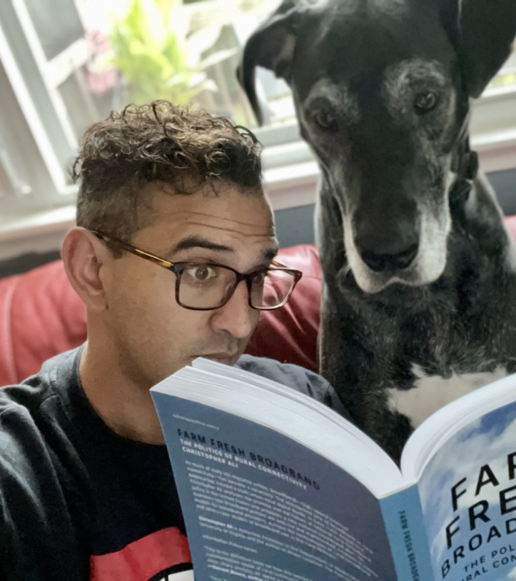
Thoughts for conversation
How are you thinking about sustainability in your network deployment strategies and/or digital inclusion programs?
How has microtrenching been working for you?
How are you planning to manage op-ex?
What are the best strategies for a state wide (or nation wide?!) dig once policies
How and where can we experiment with digital inclusion outreach and programs?
How will you make you digital inclusion programs future proof?

